Slide 1
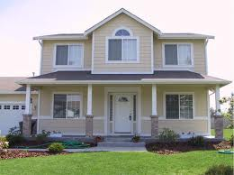
THE REVALUATION OF OUR
COMMUNITY
Questions That Are Often Asked When
A Municipality Is Undertaking A Revaluation

Slide 2
WHAT IS A REVALUATION?
A Revaluation is a program undertaken by a Municipality to appraise all real property at its fair market value.
The goal of a Revaluation is to spread the tax burden equitably throughout a Municipality.

Slide 3
WHAT IS MEANT BY “FAIR MARKET VALUE?”
Fair market value is the price at which the Municipal Assessor believes a property would sell for at a fair and bona fide sale by a private contract on October 1 of the pretax year.

Slide 4
WHY REVALUE NOW?
A Revaluation is warranted when properties in a taxing district are being assessed substantially below or above true market value.
The average property in the Borough of Harvey Cedars is currently assessed at 52.42% of market value for 2026.
The last Revaluation in the Borough of Harvey Cedars occurred in 2004.

Slide 5
WHO WILL CONDUCT THE REVALUATION?
The Borough of Harvey Cedars has entered into an agreement with Professional Property Appraisers Incorporated to perform the Borough-wide Revaluation.

Slide 6
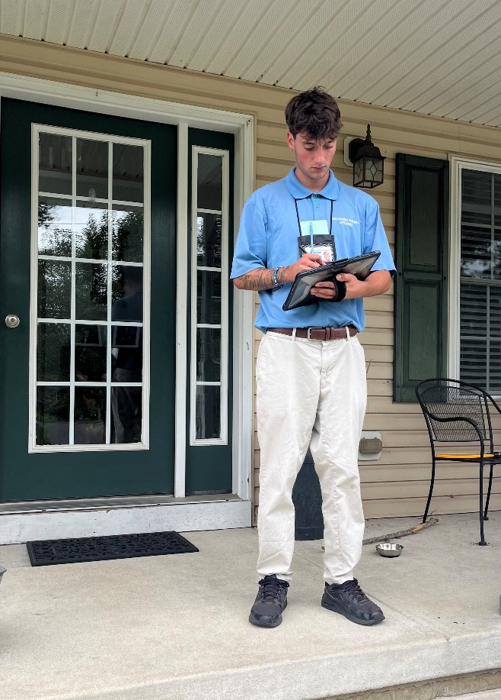
FIELD REPRESENTATIVES
Each data collector will have a photo identification badge visibly displayed. It will show the company’s name, Professional Property Appraisers, as well as the individual’s name.
The inspector can provide a letter of introduction on municipal letterhead that contains a telephone number for questions or concerns.
Ask to see the credentials of anyone seeking to enter your home and do not admit anyone who cannot produce this identification.

Slide 7
WHAT OCCURS DURING THE REVALUATION PROCESS?
Interiors and exteriors of each property are physically inspected and building dimensions are noted.
The exterior of the property will be photographed.
Recent sales will be analyzed to identify markets, sub-markets, neighborhood delineation, positive and negative locational obsolescence and land valuation.
Commercial property, typically purchased for investment purposes, is studied in terms of its income-producing capability or analyzed on a cost basis.
Residential properties will be analyzed utilizing the Sales Comparison Approach, backed up by a cost approach.

Slide 8
WHAT IS EXPECTED OF PROPERTY OWNERS?
Interior inspections, especially, require that residents cooperate with data collectors.
The validity of a market value depends on the collection of accurate data and the valuation method utilized.
Any assistance a taxpayer can provide will aid in the total data collection process. If there is information you believe should be considered in the valuation, please inform the data collector. We will make every effort to cause property owners the least possible inconvenience.
Remember, the data collectors are not responsible for determining the market value estimate. Their job is to collect pertinent information to determine the property’s value.

Slide 9
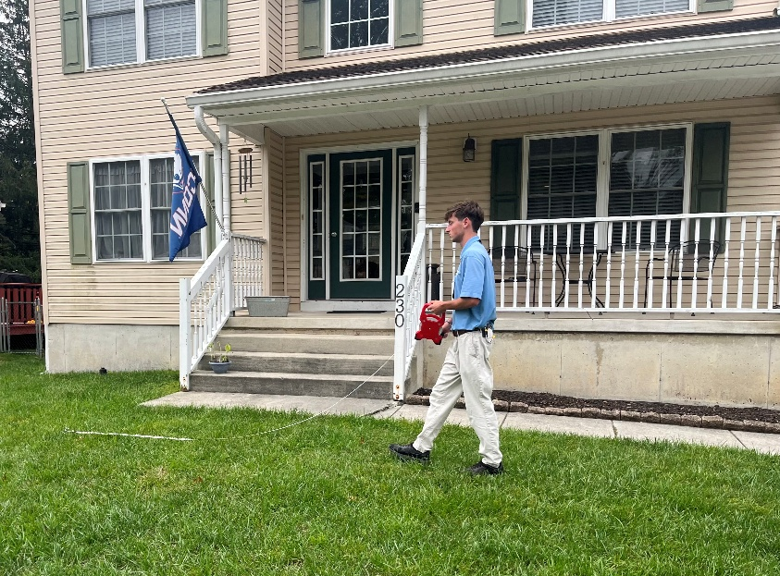
WHAT WILL DATA COLLECTORS LOOK FOR?
Data collectors will record such items as: condition, number of bathrooms, type of heat, central air conditioning, size and percentage of finished attic and/or basement areas, and number of fireplaces.
The exterior inspection includes measurements of each structure, such as: garages, in-ground pools or other accessory buildings.
Examples of what would not be noted are interior decorations, fences, window air conditioners, gas grills and landscaping, etc.

Slide 10
WHAT IF I'M NOT HOME?
Upon initial visit, a notice will be left with the Inspector’s ID Number.
Appointments can be scheduled on weekdays, evenings and Saturdays if need be.
If the representative is unable to inspect your home, the interior information will be estimated.

Slide 11
WILL MY TAXES GO UP?
Although the Revaluation will result in a change of nearly every individual assessed value, it does not mean individual taxes will increase for all properties.
The tax rate will be adjusted in 2027 to compensate for the change in the assessed values
Since not all properties have appreciated in value at the same rate, some tax levies will increase, some will stay neutral, and some will decrease

Slide 12
WILL TAXPAYERS BE INFORMED OF THEIR PROPOSED ASSESSMENT?
A notice of the new assessed values for each property will be mailed in the fall of 2026.
The impact of the new assessments will not affect the property owner’s tax bill until the 2027 tax year.

Slide 13
WHAT IF A TAXPAYER IS DISSATISFIED WITH THE PROPOSED ASSESSMENT?
The notice of your new 2027 assessed value will explain how to arrange for a personal informal meeting with a representative from Professional Property Appraisers Inc. to review the proposed assessment.
Taxpayers attending the review should be prepared to support any disagreement regarding the appraised value of their property.
For example, recent sales of similar or comparable properties or incorrect data about the home (i.e., number of bathrooms).

Slide 14

WHAT CAN A TAXPAYER DO IF HE OR SHE IS NOT SATISFIED AS A RESULT OF THE INFORMAL MEETING?
If for any reason a taxpayer is not satisfied with their assessed value for any given year, the taxpayer has the right to file a formal appeal with the Ocean County Board of Taxation on or before April 1st of that given year (Extended to May 1st for the first year after the revaluation).

Slide 15
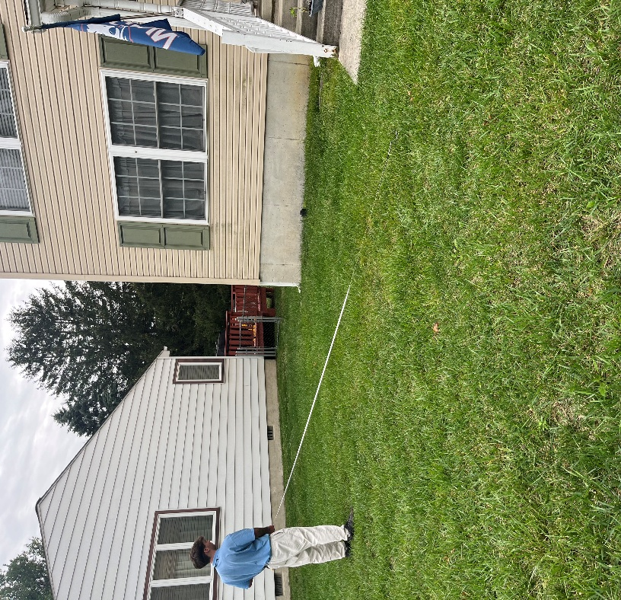
Contact Information
Professional Property Appraisers, Inc. Toll Free: 1-866-957-1388
Website: www.ppareval.com

Slide 16
Questions and Answers

